Slide 1
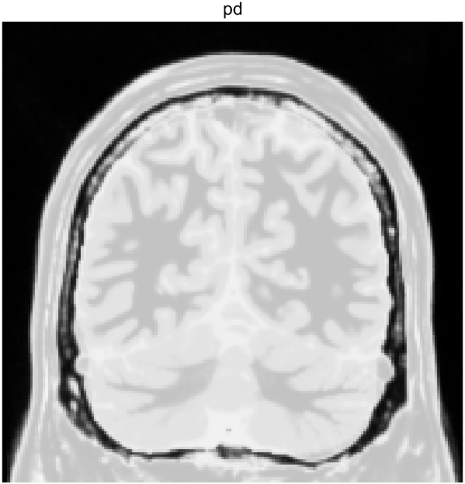
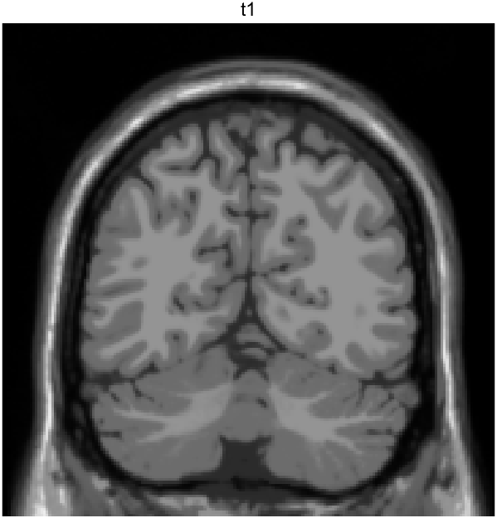
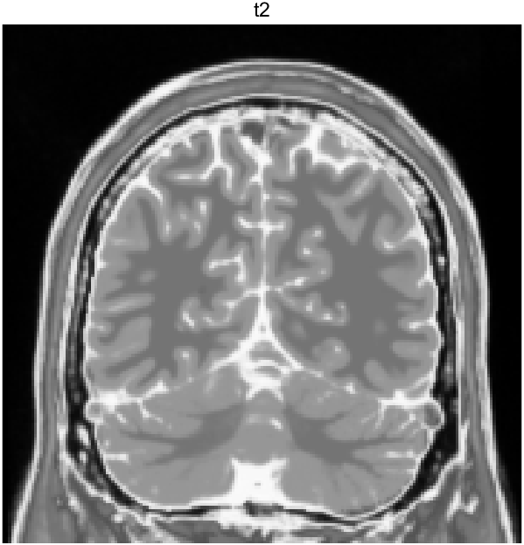
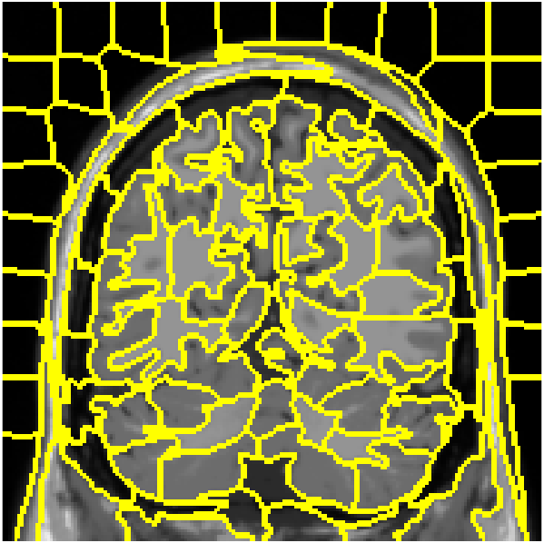






$$⋯$$
Label
Softmax
layer
$$S_{i }$$
$$S_{i,1}$$
$$S_{i,k}$$
BiLSTM layer
Fully connected
layer
BiLSTM layer
Dropout
$$i$$
$$i$$

